Slide 1

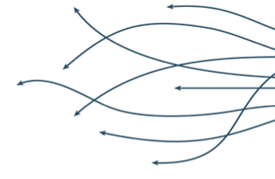

IBM Public Service
This template is designed to help you save time and energy, and also support a strong and consistent presentation of IBM Public Service’s brand.
These slides are meant to be used à la carte: Pick and choose the slides that are most appropriate for your purpose and your audience. Tailor this content as you see fit.
IBM Public Service | © 2016 IBM Corporation

Slide 2
IBM Public Service
This template is designed to help you save time and energy, and also support a strong and consistent presentation of IBM Public Service’s brand.
These slides are meant to be used à la carte: Pick and choose the slides that are most appropriate for your purpose and your audience. Tailor this content as you see fit.
IBM Public Service | © 2016 IBM Corporation

Slide 3
IBM Public Service
Success by design
IBM Public Service | © 2016 IBM Corporation

Slide 4

IBM Public Service
Success by design
IBM Public Service | © 2016 IBM Corporation
IBM Public Service | © 2016 IBM Corporation

Slide 5

IBM Public Service
Success by design
IBM Public Service | © 2016 IBM Corporation

Slide 6

IBM Public Service
Success by design
IBM Public Service | © 2016 IBM Corporation
IBM Public Service | © 2016 IBM Corporation

Slide 7

Client + IBM
Success by design
IBM Public Service | © 2016 IBM Corporation

Slide 8

Client + IBM
Success by design
IBM Public Service | © 2016 IBM Corporation

Slide 9

Client + IBM
Success by design
IBM Public Service | © 2016 IBM Corporation

Slide 10

Client + IBM
Success by design
IBM Public Service | © 2016 IBM Corporation

Slide 11

IBM Public Service
Title of Presentation
Meeting Nov. 8, 2016
IBM Public Service | © 2016 IBM Corporation

Slide 12
IBM Public Service
Title of Presentation
Meeting Nov. 8, 2016
IBM Public Service | © 2016 IBM Corporation

Slide 13
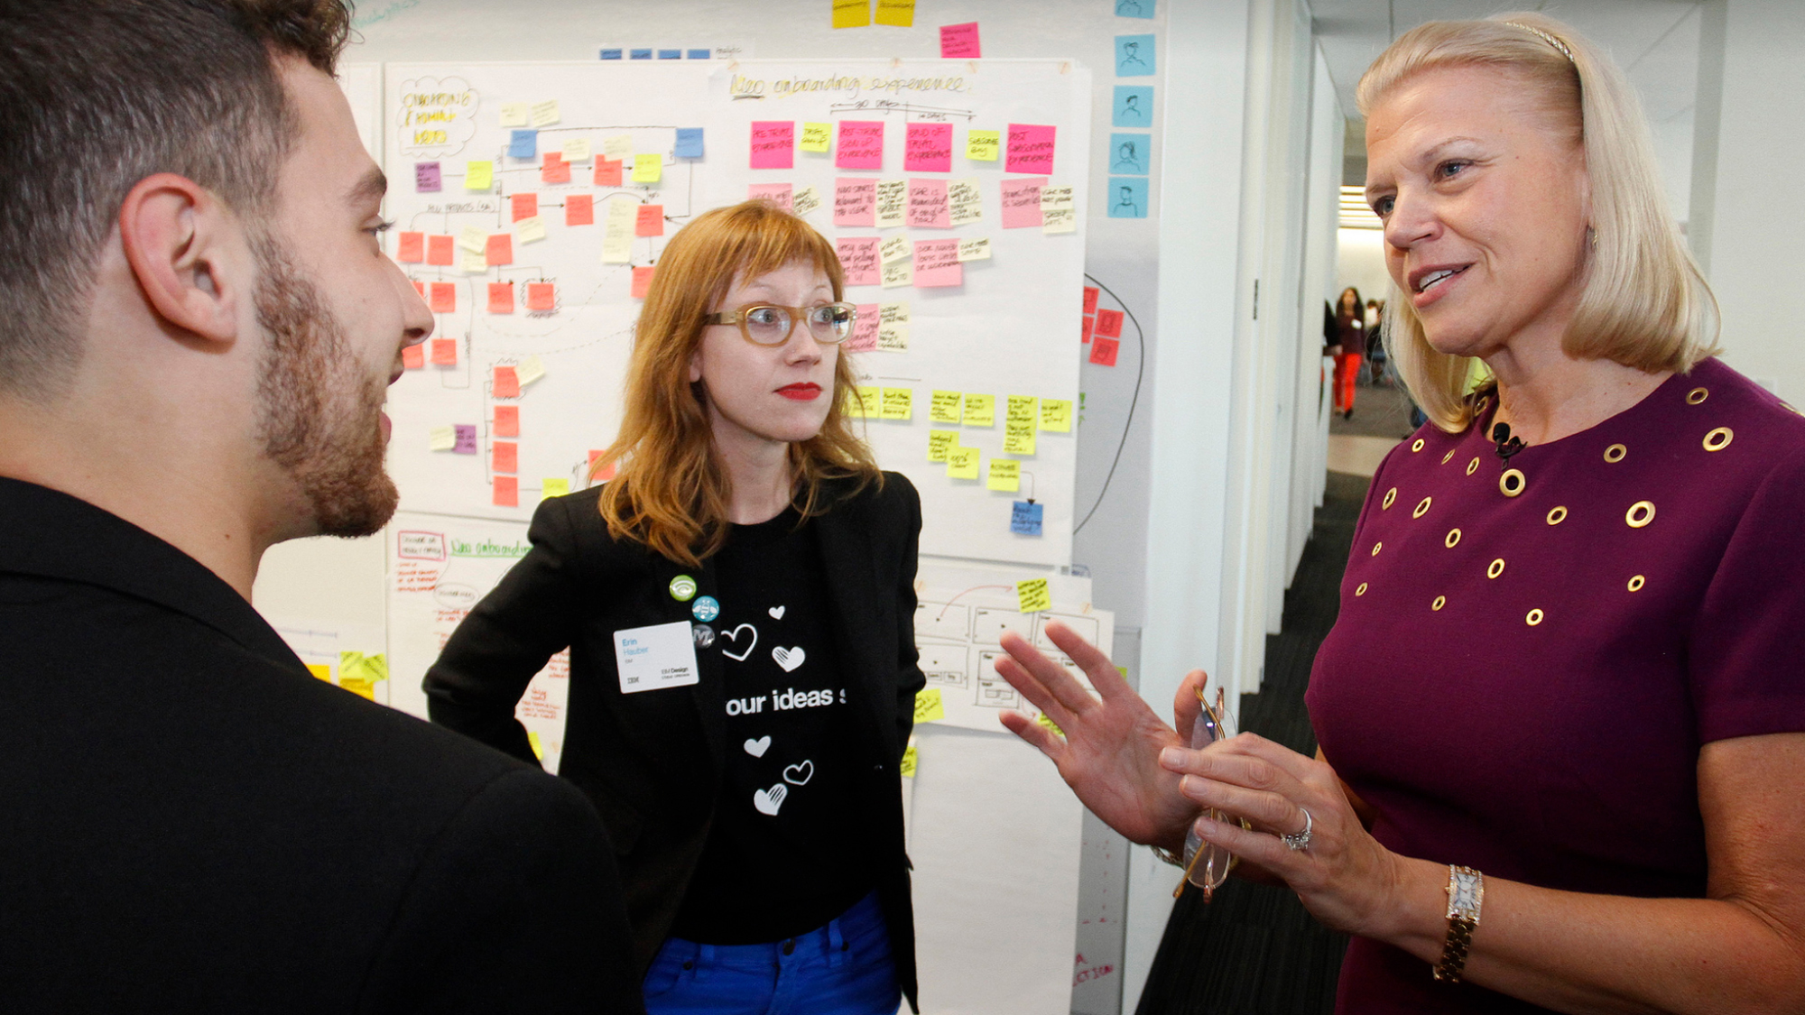
“There’s one key to our future growth: the client experience.”
IBM Public Service | © 2016 IBM Corporation
Notes:
There were many things that Ginni could have said at that moment but what she chose to say was that the experience that people have when they interact with IBM, and our products and services is what will drive the future of the company. She also had another key revelation…

Slide 14
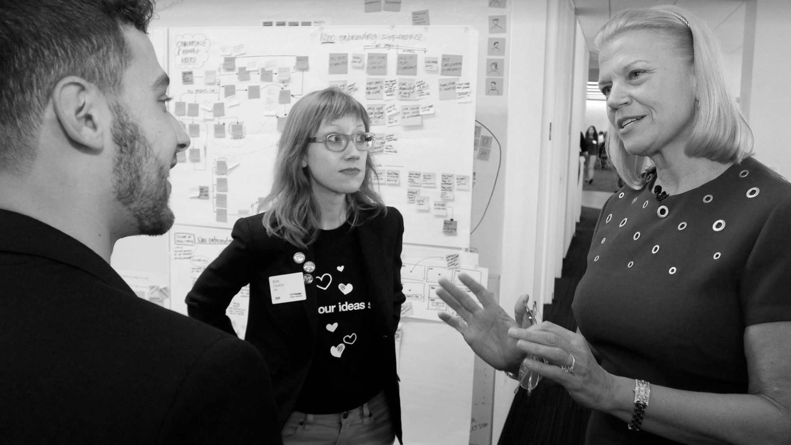
“There’s one key to our future growth: the client experience.”
IBM Public Service | © 2016 IBM Corporation
Notes:
There were many things that Ginni could have said at that moment but what she chose to say was that the experience that people have when they interact with IBM, and our products and services is what will drive the future of the company. She also had another key revelation…

Slide 15
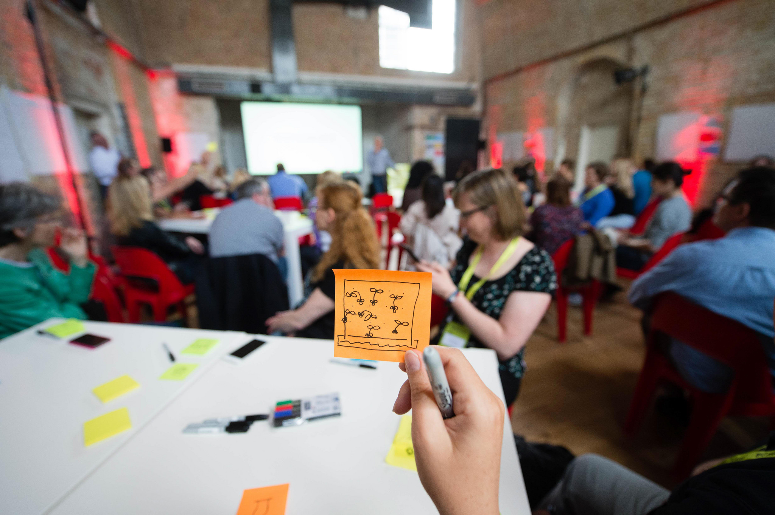
Title Header for This
Slide Topic
Consider having less words
and emphasizing the content through images
Images say a lot!
Diversity in thought makes for strong solutions
IBM Public Service | © 2016 IBM Corporation

Slide 16
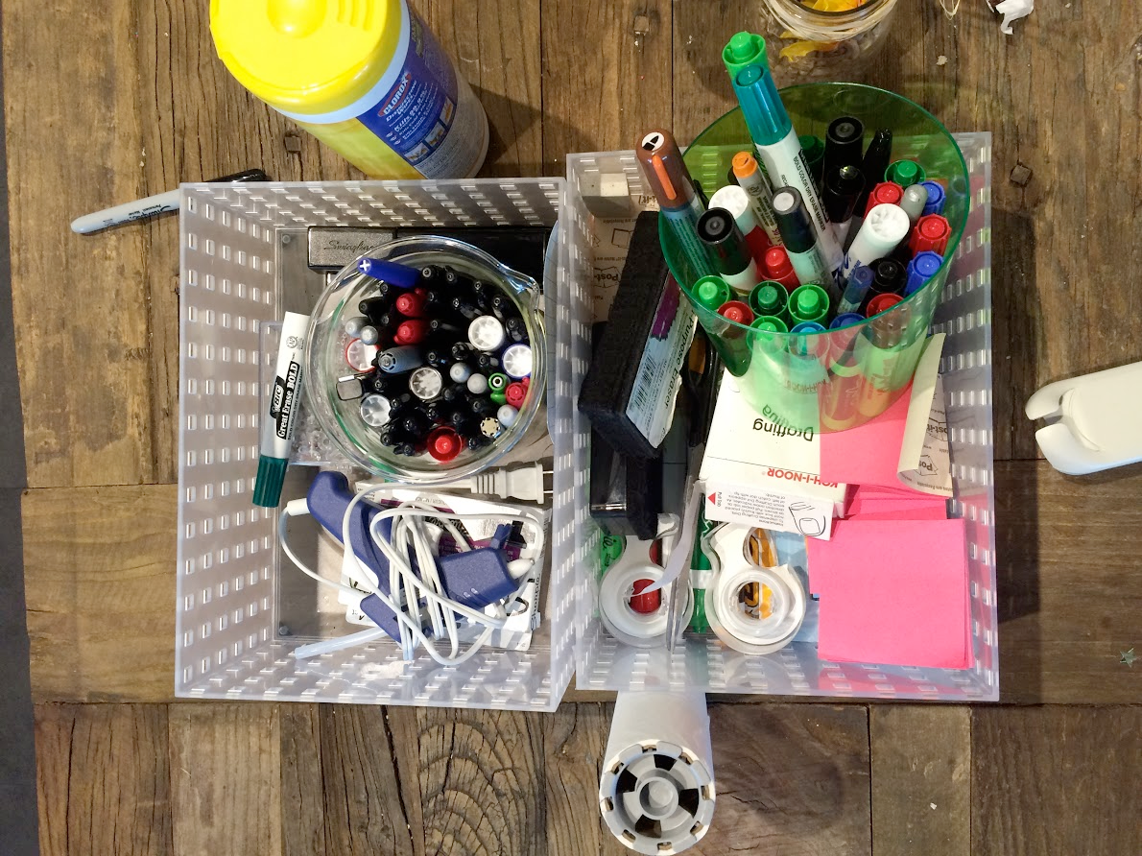
Well Equipped to
Change the World!
Supplies are the tools the workshop will use to capture ideas. When supplies feel plentiful, people are less likely to censor themselves and come up with more creative ideas. Figure out how many supplies the workshop will need, then put out twice as much.
IBM Public Service | © 2016 IBM Corporation

Slide 17

Leadership Names
First Last Name Title
First Last Name Title
First Last Name Title
IBM Public Service
First Last Name Title
First Last Name Title
First Last Name Title
First Last Name Title
First Last Name Title
IBM Public Service | © 2016 IBM Corporation

Slide 18

Leadership Names
First Last Name Title
First Last Name Title
First Last Name Title
IBM Public Service
First Last Name Title
First Last Name Title
First Last Name Title
First Last Name Title
First Last Name Title
IBM Public Service | © 2016 IBM Corporation

Slide 19
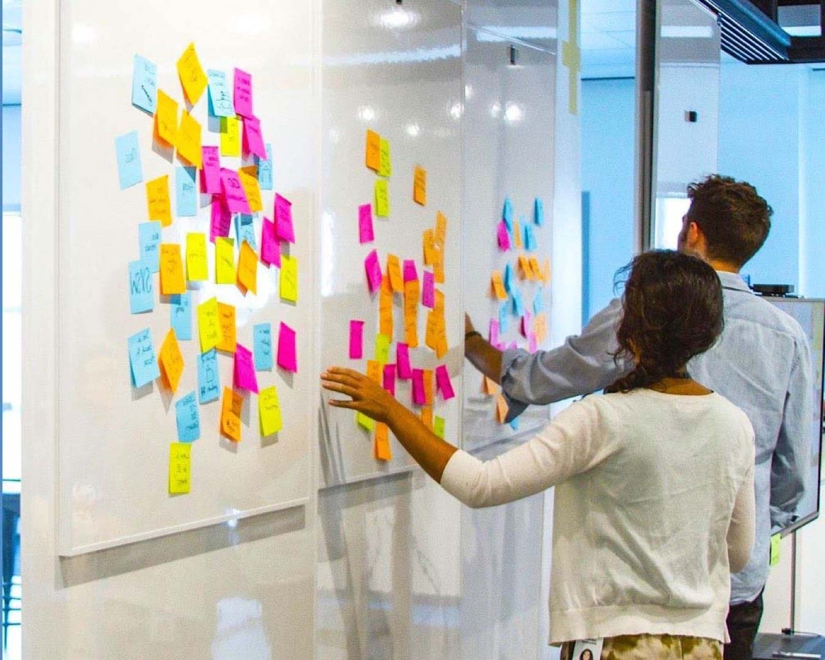
We use IBM Design Thinking to understand and improve the experiences that people have with IBM products and services.
IBM Design | © 2016 IBM Corporation
IBM Public Service | © 2016 IBM Corporation

Slide 20



Put the Person First
Every project has multiple people that are going to experience the excellence in your work. Who are they? What do they care about? How can you be that one person advocating for their best experience?
Persona Person One
Subtext to define person here
Further subtext here
Persona Person Two
Subtext to define person here
Further subtext here
Persona Person Three
Subtext to define person here
Further subtext here
IBM Public Service | © 2016 IBM Corporation
Notes:
The Management Leader is a Band 10 who sets the direction for and leads the studio’s growth. Empowered to make decisions by executive sponsors, the manager oversees the design of the space, develops the studio’s functions, and ensures the studio enables outstanding, design-driven outcomes for clients.
The Design Leader, also a Band 10, is the Studio’s creative visionary. The Design Leader sets the standards for practice, champions IBM Design Thinking, sets bar for talent, and leads outstanding design outcomes. A visionary, the Design Leader collaborates with the Management Leader to design and deliver offerings to clients of all types.
The Operations Coordinator makes sure the Studio hums on a day-to-day basis. From badge access to room reservations, from space management to tour coordination, the Operations Coordinator provides white glove service to clients, studio residents, and IBM executives alike.

Slide 21













Complex Digital Transformations means lots of people are involved
We’re transforming the entire ecosystem of an agency that serves the public. It’s good to know who is involved at every angle.
Residents
Users
IBM Executives
Analysts
Design, Engineering, Offering Management
Design, Engineering, Clients, Consultants, BAs, Partners, etc.
Whole Teams
Press
Studio Leaders
Clients
IBM Public Service | © 2016 IBM Corporation

Slide 22





Chunk Information It makes it easier to read through
Who
Client key stakeholders
Client business leaders
Client executive sponsors
IBM Design Leaders
What Conduct interviews, gather insights,
and prepare for executive workshop.
Outcomes Understand business and technical environment with current capabilities,
limitations, opportunities, and unknowns. Refine design prompts and identify personas for the workshop.
IBM Involvement
Design Leaders
Design Thinking SMEs
User Researchers
IBM Public Service | © 2016 IBM Corporation

Slide 23
A simple /
clear title
A cultural embrace of design as a practice that places a focus on user experience and cross-discipline collaboration to create experiences that delight your customers.
IBM Public Service | © 2016 IBM Corporation

Slide 24

Don’t overwhelm with too much info. It should be clear and easy to see the take away.
Design a better way for a financial security analyst to immediately and effectively prioritize the most vital imminent threats.
How might we improve the workspace of an app developer to make them more confident and productive?
How might we provide a more personalized experience for a job applicant based upon their preferred communication style?
Design a better way for a commercial tenant to have their maintenance issue resolved without ever having to talk to another person.
How might we make patients feel like their time isn’t being wasted while they’re in the waiting room?
How might we use data to help a corporate recruiter make decisions about candidates and roles, faster and with higher confidence?
Design a better way for a business traveler to get from curb to gate at a hub airport much more quickly, possibly by leveraging biometric data.
How might we provide personalized client support from a virtual command center while also improving response time by at least 10 percent?
How might a data analyst better understand and exploit data that currently exists within her database?
Design a better way for a police officer to access the digital tools he needs to get his job done, safely and effectively.
For your workshop, we’d like you to send to us at least 8 problem statements—here are some examples.
We’ll then edit them down to a few “finals” for you to choose from, and those will be what we’ll use for the workshop.
IBM Design | © 2016 IBM Corporation

Slide 25
Simple Shapes to articulate a plan and phases
Inform
Set Baseline
Collaboratively set
scope, scale, timing
Implement, refine, repeat
Program
Implementation
@ scale
Education
Workshop
Project
Kickoff
Executive
Workshop
12-36 months
2 days
2 weeks
1-2 days
Hallmark
Projects
12+ weeks
IBM Public Service | © 2016 IBM Corporation

Slide 26



Keep Details High Level. Reports in Presentations can often
be overwhelming. Don’t do that.
1. Start Up
Deliver first outcomes. Staff and begin program.
2. Scale up
Ramp up number of projects and pace of outcomes. Capabilities transferred from IBM to Client.
3. Self-sustain
Attain steady-state capacity in a self-sustaining mode.
Target capacity at steady state
Program capacity
(number of projects)
IBM Program
Support Staff
Continuous delivery of outcomes from the start
0
1
2
3
Years from start of initiative
(example scale)
IBM Public Service | © 2016 IBM Corporation

Slide 27
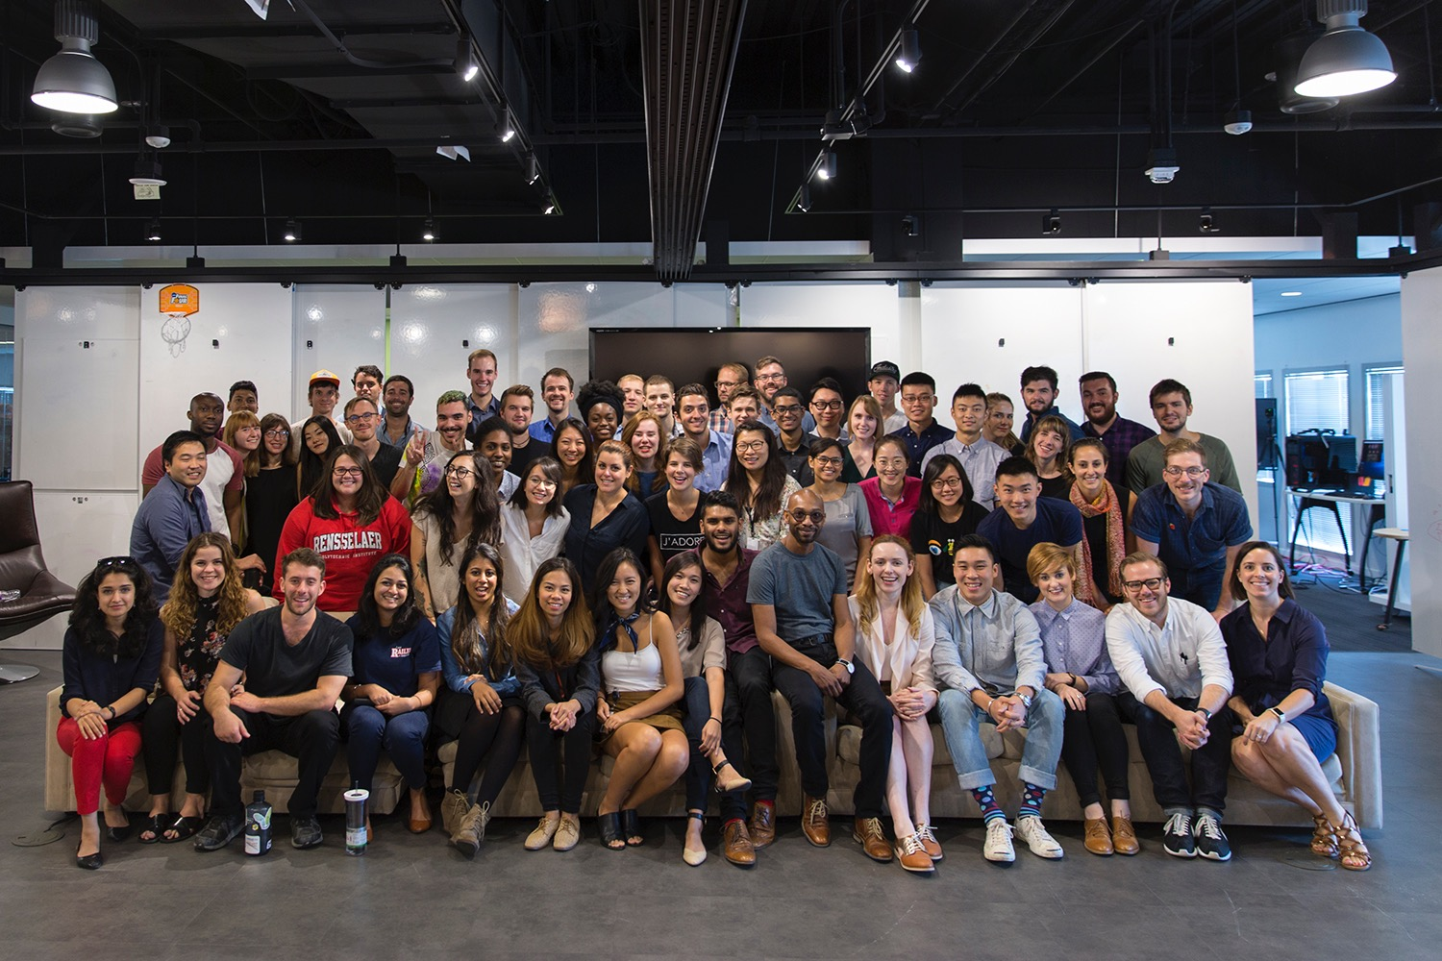

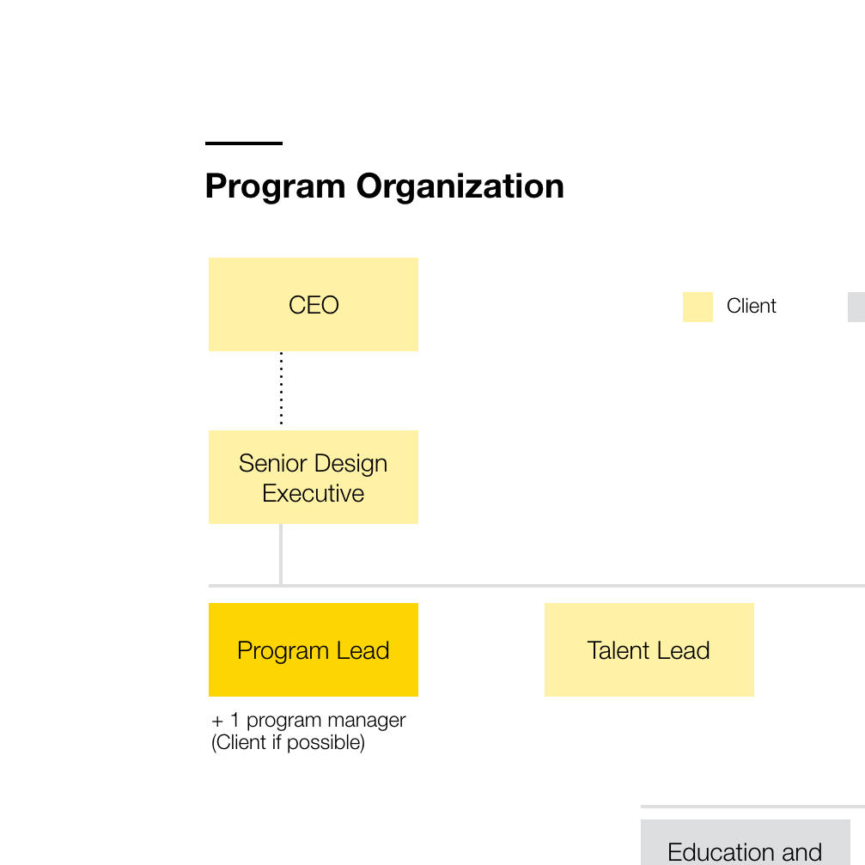
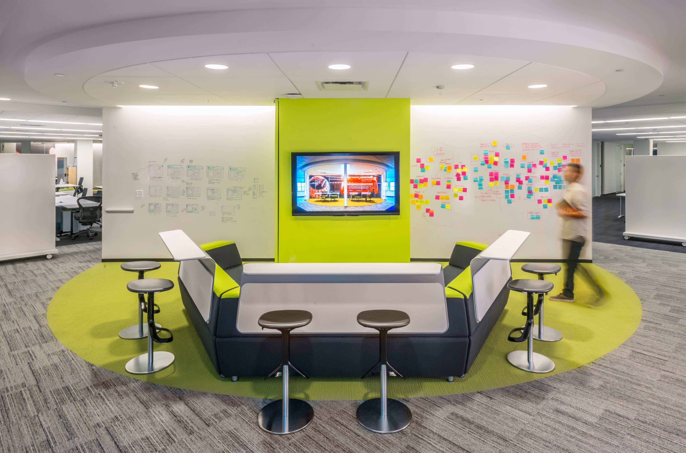

What makes IBM different?
Scale: We are the only company to conduct a Design Transformation at this scale—we have staffed over 1,000 designers in 3 years with a goal of 1,500 total.
Bundled Services: On top of our design thinking workshops, we are able to fold in our products and services to help deliver solutions to the market.
Organizational Transformation: We can help setup your design practice and provide insights on the organizational structure, lessons learned, and best practices
Resources: We are able to accelerate your transformation via co-location of designers from our services arm and provide studio space
Experience: We have a long history of design excellence.

Slide 28
Use simple shapes and bold IBM colors to show structures
CEO
Senior Design Executive
Program Lead
Talent Lead
Design Practice Lead
Studios Lead
Education and Activation
Design Practice Development
IBM Public Service | © 2016 IBM Corporation

Slide 29




Use simple shapes and bold IBM colors to show structures
+
+
People
Practices
Places
Critical program leaders
Executive sponsorship
The right ratio of designers for your organization
Outcomes
The right approach for your business
Your own design language
Your own internal training strategy
Inspirational design spaces
Collaboration spaces
A design community
IBM Public Service | © 2016 IBM Corporation

Slide 30
Key Learnings
Problem
Approach
It takes years to build experience at scale and create a self-sustaining capability.
Gain executive support for a multi-year roadmap.
IBM Public Service | © 2016 IBM Corporation

Slide 31




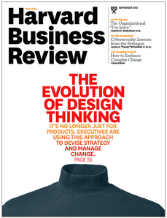


IBM Design: What others are saying
“When it comes to building a modern building design organization, the best examples comes from IBM.”
Leah Buley, Principal Analyst, Forrester
“I predict large tech companies will place greater attention on design. […] We see it already with Google, eBay and IBM’s resurgence in the design space with its new Austin center led by Phil Gilbert.”
John Maeda, Partner KPCB
“I’ve never seen any company implement [design thinking] on the scale of IBM,”
William Burnett, executive director of the design program at Stanford University.
“Words I never expected to write: Elegant, thoughtful, design guidelines and examples from IBM.”
John Gruber, Daring Fireball
“As industry giants such as IBM realize that software is a fundamental part of their businesses, they are also recognizing the extraordinary levels of complexity they must manage. Design thinking is an essential tool for simplifying and humanizing. It can’t be extra; it needs to be a core competence.”
Jon Kolko,
HBR, September 2015
“Everyone [at Kaiser] was very complimentary of the briefing. IBM Design was a big part of setting us apart from our competition.”
Wendy Won, VP Kaiser Permanente Account

Slide 32

We have a global perspective. We bring this to our clients

Slide 33
Design Thinking Workshop Schedule
Nov-17-16 | Topic | Explanation
8:30 – 9:00 | Welcome and Introductions (NAX) | Welcome—we’re glad to have you here with us! Name, What you do, and one Fun Fact.
9:00 – 9:45 | Vision (Kacie / Nicole / Tarver /), Design Exercise (VERA), Hopes and Fears (NAX) | 1. Why we’re here. 2. Warm up with Design Exercise. 3. Hopes and Fears Activity
9:45 – 10:00 | Break | Please be ready promptly at 10AM
10:00 – 11:00 | Empathy Mapping (NAX) | Identify the story of a veteran we are designing for. Identify what he/she is thinking, feeling, doing, and saying.
11:00 – 12:00 | Relationship Map (VERA) | We’ll identify all the possible people a veteran could have in their life and the possible impact on a veteran’s life.
12:00 – 12:30 | Lunch and discussion | Informal, informative, fun, and tasty.
1:00 – 1:45 | Scenario Mapping (NAX) | We’ll identify different phases (vignettes) of a veteran’s life and map what he/she is doing, saying, and feeling at that moment.
1:45 – 2:30 | Big Ideas (VERA) | Now that we have a stronger understanding of a veteran experience, this activity is a great way to rapidly brainstorm a breadth of possible ideas.
2:30 – 2:45 | Break | Please ready promptly at 2:45AM
2:45 – 3:30 | Prioritization Grid (NAX) | This activity helps your team evaluate and prioritize ideas by focusing discussions on importance and feasibility
3:30 – 5:00 | Playbacks (VERA) (NAX) | It all comes together in the Playback session.
5:00 – 5:30 | Next Steps (Tim / Krumble / Kacie)
IBM Public Service | © 2016 IBM Corporation

Slide 34
How to Stand This Up Together
Phase 1
Phase 2
Ongoing
Hallmark
Program
Discovery activities
Executive workshop - Select Hallmark Projects from each LOB to launch, and get rolling
Assign Partner Project managers and offer internal resources as needed
Develop communications strategy
Meet regularly with executives to identify, filter and prioritize projects
Onboard qualified projects, off-board completed projects
Review KPIs, troubleshoot, and adjust
People
Plan for staffing support of projects (IBM migrating to Partner)
Assign Program Lead and Practice Lead
IBM designers assigned to projects as needed to meet staffing ratio
Partner Talent lead assigned
Staffing to meet evolving needs of the projects in the Hallmark Program
Talent development activities
Practices
Scope education and activation needs for initial slate of projects and associated managers/executives
Run bootcamp(s) for incoming teams and their executives
Adapt and codify design thinking practices
Hold Hallmark Project playbacks with executive team
Continue to run bootcamps for incoming teams, adapt and codify practices
Places
Develop places/studio strategy, digital support, location logistics, etc. as needed
Secure workspace for project teams, start planning space expansion if needed
Build out studios as needed
Deploy teams and leaders into studios as they come into the program
IBM Public Service | © 2016 IBM Corporation

Slide 35
The only company to conduct a design transformation at this scale
Unique in our focus on the Enterprise market
Able to accelerate your transformation via co-location of designers from our services arm and provide studio space
Able to fold in our other products and services as desired (ex: Watson).
Long history of Design excellence
Why IBM?
IBM Public Service | © 2016 IBM Corporation

